Slide 1
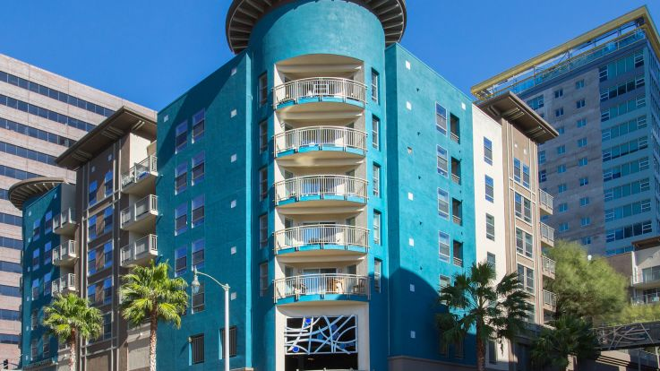

A PROJECT FOR NOBROKER TO PREDICT THE RENT OF PROPERTY
PRESENTED BY:
EHATSHAMUDDIN
DEEPENDRA SINGH
ASHUTOSH KUMAR
AKHILESH DHAKER
BITTU KUMAR
PRITEE KUMARI

Slide 2
INTRODUCTION
1 LAKH PROPERTY DATA FROM A PARTICULAR CITY. WILL HAVE AROUND 50 ATTRIBUTIES OF THE PROPERTY.
DATA OF THE NEIGHBOURHOOD OF THESE PROPERTIES.
HIGH GROWTH IN POPULATION HAS RESULTED IN HIGH DEMAND FOR BUYING OR TAKING PROPERTIES ON RENT.
IT AVOIDS THE BROKER.
THE BUYER OF PROPERTY CAN ABLE TO KNOW THE EXACT PRICE OF THE PROPERTY.

Slide 3
AVAILABILITY OF FINANCE
RISING TOURISM
CONSTRUCTION
RISE OF MIDDLE CLASS
DECLINE OF JOINT FAMILIES

Slide 4
We have collected data of 1 lakh properties from KaggleS.
WE HAVE DESIGN A MACHINE LEARNING ALGORITHM THAT SELF PREDICT ACTUAL PRICE OF PROPERTY.

Slide 5
STRONG DEMOGRAPHICS
FISCAL
POLICY
CONSTRUCTION
RISING FDI
ATM FACILITY

Slide 6
FIRST TIME BUYERS
INTERNATIONAL TOURISM
CONSTRUCTION
DEVELOPMENT OF NEW STREAM OF BUSINESS
MEDICAL TOURISM

Slide 7
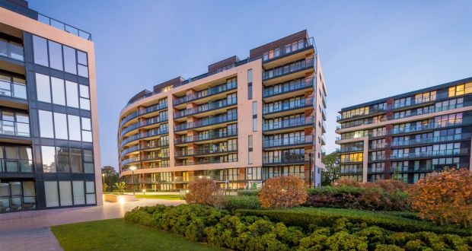
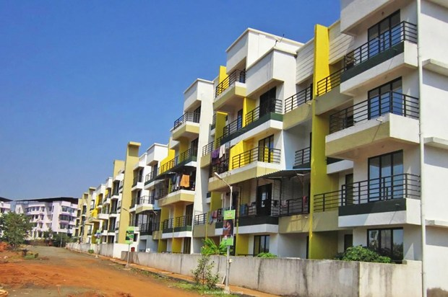
BY THIS PROPERTY DATA WE CAN PREDICT THE PROPERTIES OF BANGLORE CITY. FOR STORING THIS LARGE AMOUNT OF THE DATA WE USE THE CONCEPT OF BIGDATA HADOOP.
WE HAVE TAKEN 50 ATTRIBUTES OF 1 LAKH PROPERTIES AND ON THE BASIS OF THESE WE WILL PREDICT THE PRICE OF NEW PROPERTIES.

Slide 8


Slide 9
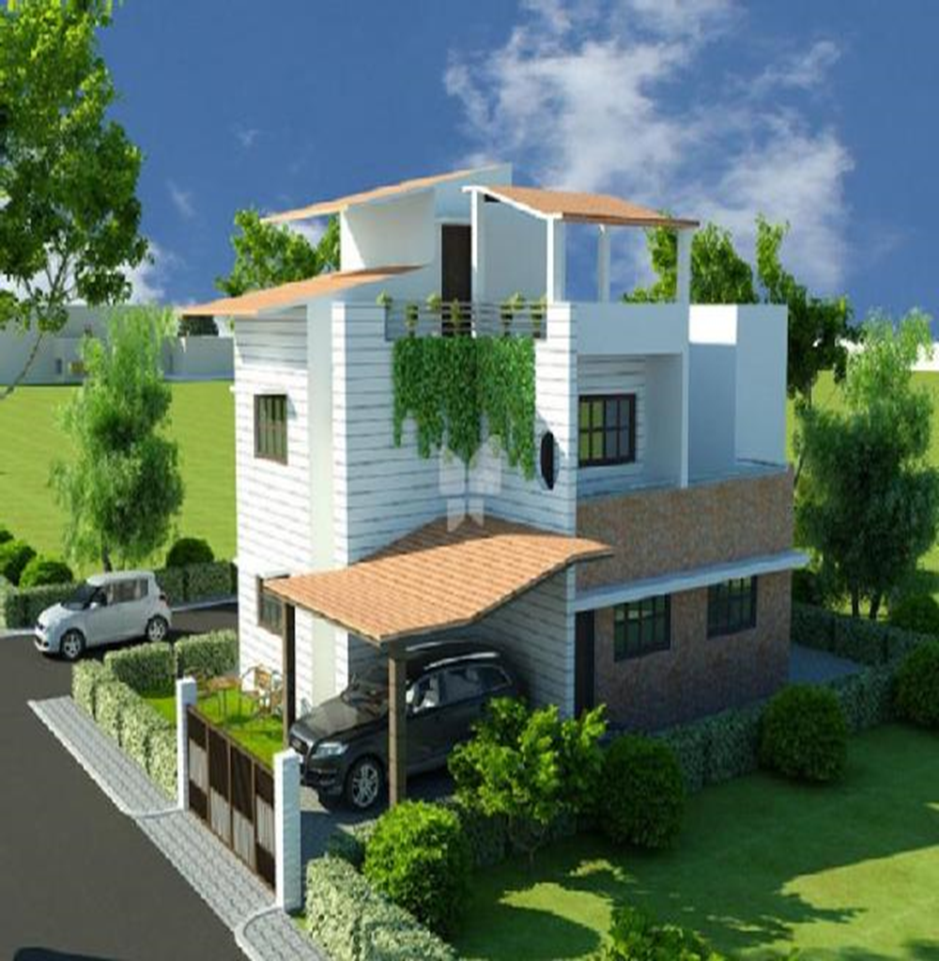

YOUR DREAM HOMES

Slide 10
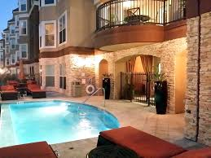
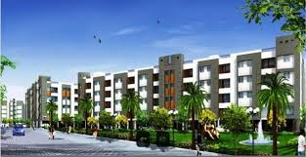

Slide 11
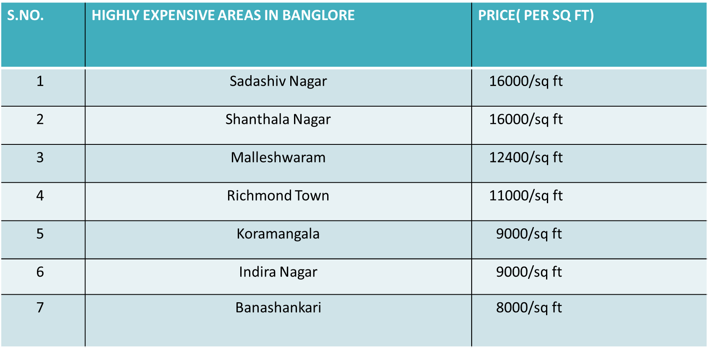

Slide 12
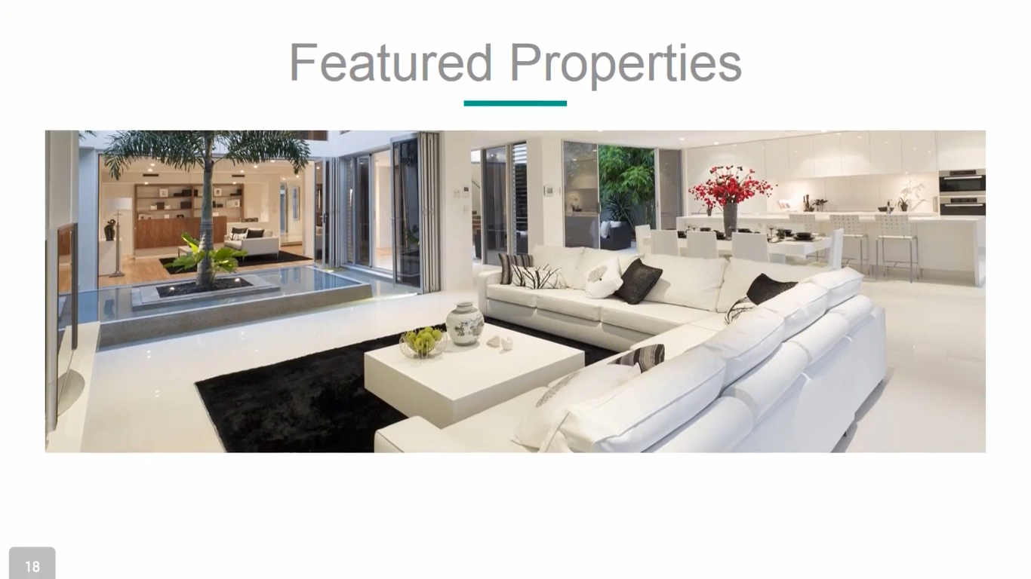

Slide 13
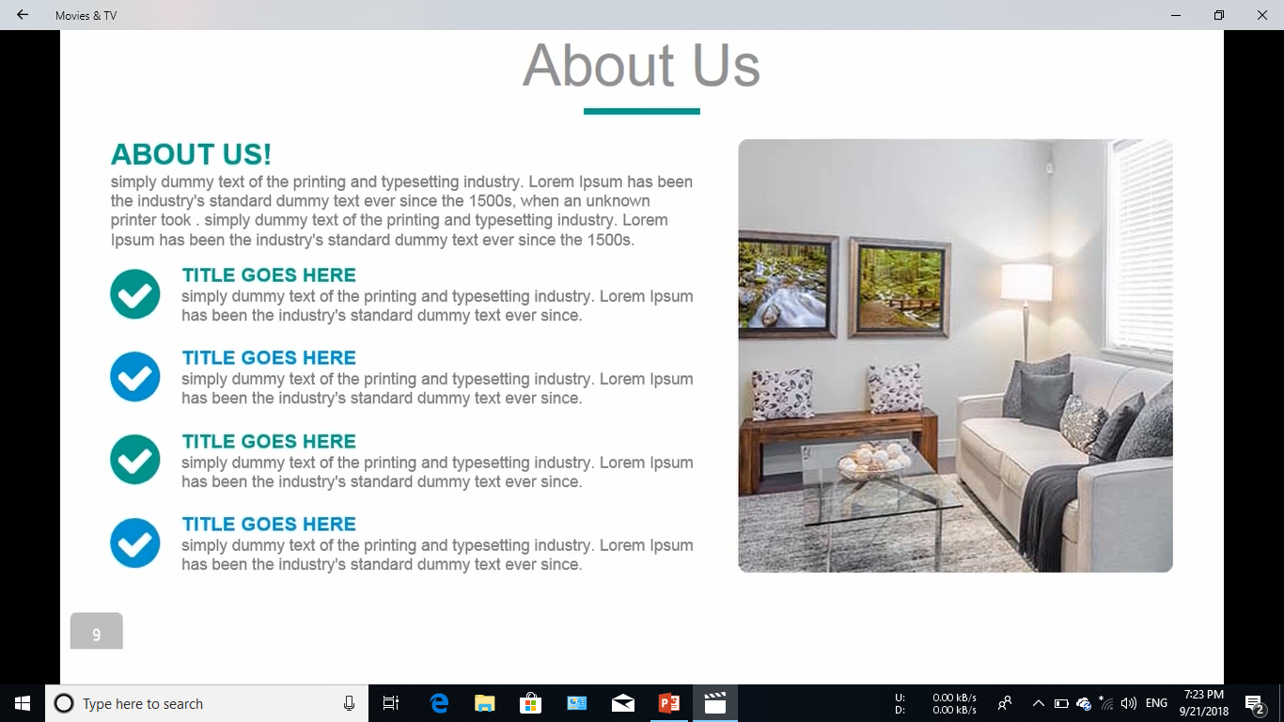

Slide 14
TARGETS BY OUR TEAM MEMBERS:-
TO MAKE A WEBSITE FOR MAKING EASY TO CALCULATE THE RENT OF THE PROPERTY.
IT WILL BE TOTALLY FREE FROM BROKERS.
EASY TO USE.

Slide 15
THANK YOU
FOR FURTHER DETAIL CONTACT:-
9784373088,9430513765,9878765463
akhileshdhaker777@gmail.com

